Slide 1



Slide 2



 | Slope Bins 4 | Smear Count 25
Block number | Alpha w/ Henderson Hasselbalch | Chi Chi_max = 2.2
[0 50] | 0.040012 | 1.160000
[50 75] | -0.278451 | 0.720000
[75 125] | -0.519707 | 0.608000
[125 156] | -0.154453 | 0.529032

Slide 3


 | Slope Bins 4 | Smear Count 31
Block number | Alpha w/ Henderson Hasselbalch | Chi Chi_max = 2.2
[0 31] | 0.001103 | 0.922581
[31 62] | -0.386873 | 0.703226
[62 93] | -0.290146 | 0.967742
[93 496] | 0.037164 | 1.098759
[496 527] | -0.064533 | 0.819355
[527 620] | 0.010682 | 0.756989
[620 647] | -0.103326 | 0.696296

Slide 4
Binary results

Slide 5



Matrix Approach
Updated 04/04/2023

Slide 6











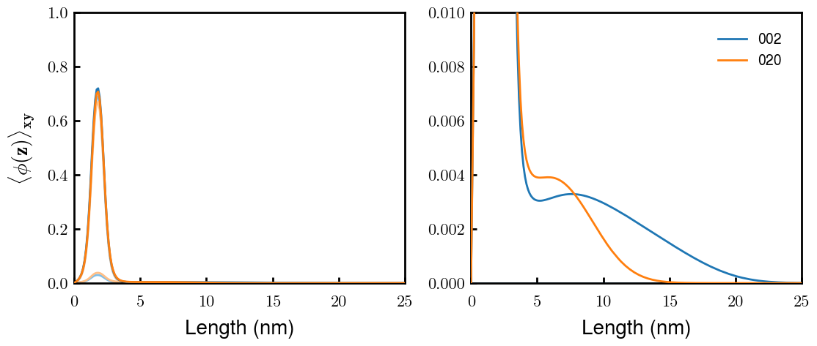
H Vol decrease (by v)
H Vol decrease (by b)
a2C_30
a2D_30
a2E_30
Rerun for Cs
b1C_30
b1D_30
b1E_30
L Vol decrease (by b)
a1C_30
a1D_30
a1E_30
g1C_30
g1D_30
g1E_30
Rerun for Cs

Slide 7



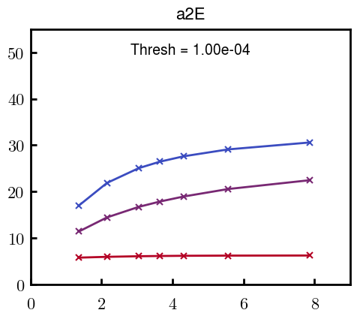
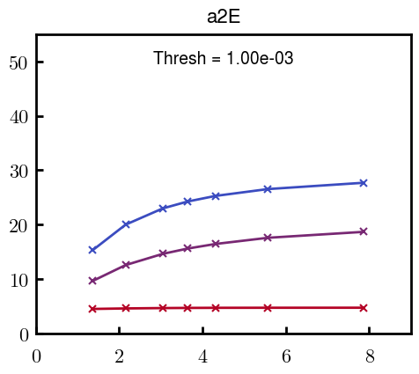



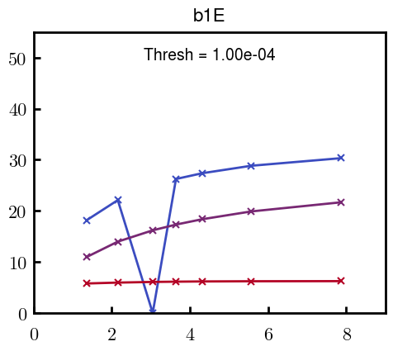
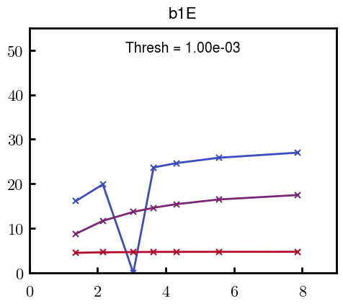



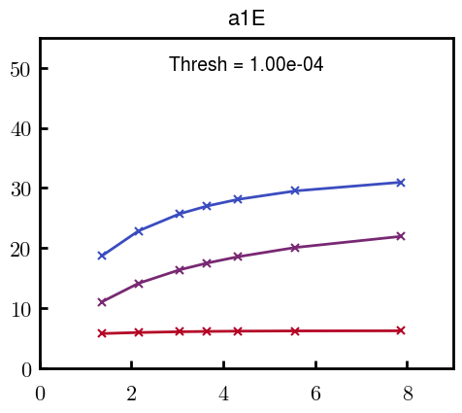
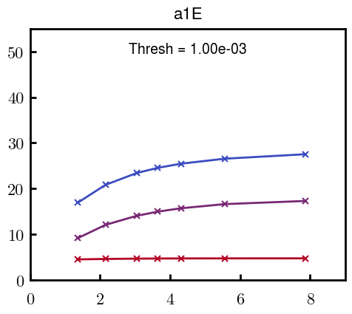



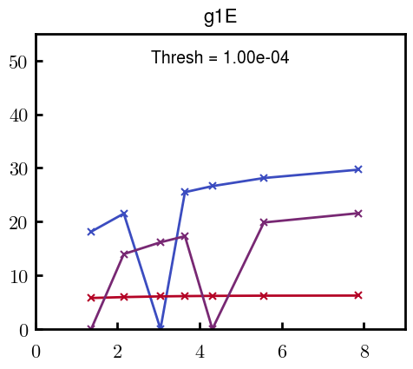
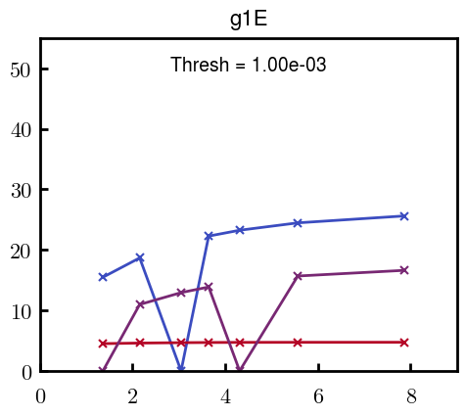
H Vol decrease (by v)
H Vol decrease (by b)
L Vol decrease (by b)

Slide 8







For i as L and H:
Pure height profiles
Mixed height profiles
Current L library
Current H library
Skip; marginal increase in vol prob not enough
Move onto chi3.0; larger NFL vol library

Slide 9





NFL
All plotting wrong L pure; look only at purp
NFH
H volume too low to neutralize L (v = 31 nm3/c)

Slide 10







H volume v = 60 nm3/c

Slide 11







H volume too low to neutralize L

Slide 12








NFH, V = 70

Slide 13





NFH & NFL v = 0.15
a2D
b1D
g1D

Slide 14





Based on NFH b5v15c3, apply VL = VH
NFL and NFH are from same amino acids but diff chain lengths. Should VL = VH?
L30 / H70
L80 / H20
L30 / H70
L80 / H20

Slide 15




L30 / H70
L80 / H20
L30 / H70
L80 / H20

Slide 16
L Fitting

Slide 17


VL = VH

Slide 18







Try b change, v same as H (0.15)
Phi unrealistic (?)
Phi unrealistic
Phi very unrealistic
Phi very unrealistic

Slide 19






Try similar params to H
5.6
11.2
16.8
28
56
7.5
11.25
18.75

Slide 20







Try similar params to H, b0.36
7.8
15.6
23.4
31.2
Unrealistic vol
Not very sensitive to v; not high enough to intersect neighboring chains (function of b and sigma)

Slide 21


Continuation from prev params

Slide 22







v2.7 and some fine
b1.50 v2.7 c3.2
b1.75 v2.7 c3.2
b1.75 v2.5 c3.2
b1.75 v2.5 c3.0
b2.0 v2.7 c3.2
b2.25 v2.7 c3.2
b2.50 v2.7 c3.2
Phi too small to decrease v0

Slide 23










b2.0 v10.0 c3.0
b2.0 v8.0 c3.0
b2.0 v6.0 c3.0
b2.0 v4.0 c3.0
b2.0 v2.0 c3.0
Phi limit
b1.8 v10.0 c3.0
b1.8 v8.0 c3.0
b1.8 v6.0 c3.0
b1.8 v3.0 c3.0
b1.8 v2.0 c3.0
Phi limit

Slide 24





b1.6 v10.0 c3.0
b1.6 v8.0 c3.0
b1.6 v6.0 c3.0
b1.6 v2.0 c3.0
b1.6 v1.5 c3.0
Phi limit

Slide 25


Response to stimuli given composition
Same data
Effect of composition given environment

Slide 26


NFL, pH 7.44, phos 1.5e (locs from LCMS)
Non-phos NFL
Block number | Alpha w/ Henderson Hasselbalch | Chi Chi_max = 3.2
[0 50] | 0.040012 | 1.540000
[50 75] | -0.278451 | 0.960000
[75 125] | -0.519707 | 0.868000
[125 156] | -0.154453 | 0.690323
 | Slope Bins 4 | Smear Count 25
Block number | Alpha w/ Henderson Hasselbalch | Chi Chi_max = 3.2
[0 50] | -0.019988 | 1.540000
[50 75] | -0.278451 | 0.960000
[75 125] | -0.519707 | 0.868000
[125 156] | -0.154453 | 0.690323

Slide 27


NFH, pH 7.44, phos 1.5e (locs from LCMS)
 | Slope Bins 4 | Smear Count 36
Block number | Alpha w/ Henderson Hasselbalch | Chi Chi_max = 3.2 | Chi Chi_max = 3.0
[0 36] | 0.000945 | 1.266667 | 1.20000
[36 72] | -0.527455 | 0.900000 | 0.85000
[72 324] | -0.208376 | 1.729365 | 1.628571
[324 396] | -0.111195 | 1.416667 | 1.333333
[396 432] | -0.152824 | 1.344444 | 1.266667
[432 647] | -0.033955 | 1.077209 | 1.015814

Slide 28

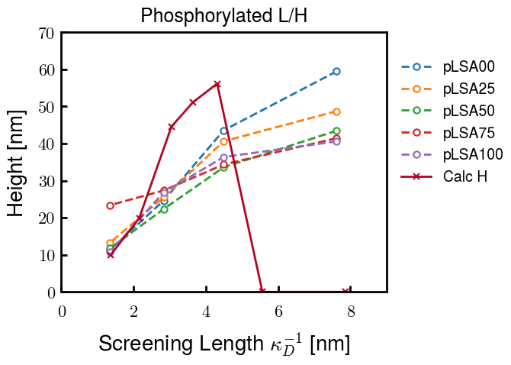
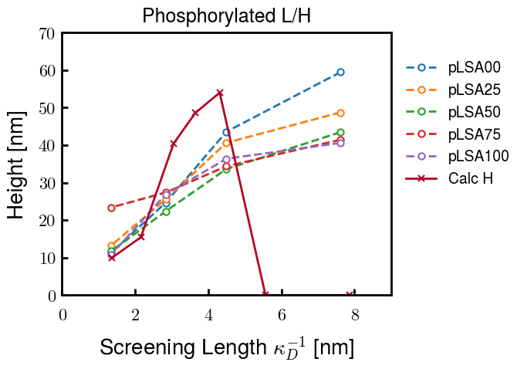
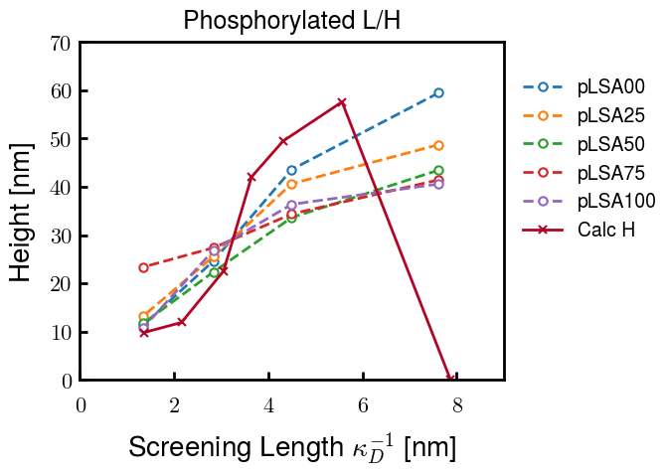
Instead of fitting b/v, could just change value of charge on phos. Try both and see if makes difference for mixture

Slide 29









b2.0 v2.7 c3.2
b3.0 v3.5 c3.5
b3.0 v7.0 c3.5
b3.0 v7.0 c3.0
Phi too small
Phi too small to decrease v0
b4.0 v12.0 c3.0
b5.0 v20.0 c3.0
b5.0 v20.0 c4.0
b5.0 v5.0 c3.0
b5.0 v10.0 c3.0
Phi too small to decrease v0

Slide 30





v20
b5.0 v20.0 c3.0
b4.5 v20.0 c3.0
b4.0 v20.0 c3.0
b3.5 v20.0 c3.0
v10
b5.0 v10.0 c3.0
b4.0 v10.0 c3.0
b3.0 v10.0 c3.0
b2.0 v10.0 c3.0

Slide 31




b2.00 v2.70 c3.20
b2.00 v2.75 c3.20

Slide 32
NFH fitting (from NFL best fit)

Slide 33








b1.00, v0.50, c3.2
b2.00, v4.00, c3.2, th2.5e-02
b1.00, v2.00, c3.2
b1.00, v1.00, c3.2

Slide 34
Mixture

Slide 35



Slide 36


b = 0.75

Slide 37





Slide 38
b = 1.0

Slide 39





Slide 40
b = 1.25

Slide 41




Chi 2.6
Bad vol frac

Slide 42








b25v0
b25v1
b25v2
b25v3

Slide 43




Chi 2.8
Bad vol frac

Slide 44





Slide 45
b = 1.50

Slide 46






Chi 2.8
Bad vol frac

Slide 47





Slide 48

b = 2.00
v4 = 0.25*b^3

Slide 49


Bad vol frac

Slide 50



Slide 51
Fine tune

Slide 52



b1.25, v1.95, c3.0
b1.50, v3.38, c3.0
b2.00, v4.00, c3.0
Norm seems to capture kinked behavior

Slide 53




Slide 54



b1.25, v1.95, c3.2
b1.50, v3.38, c3.2
b2.00, v4.00, c3.2

Slide 55




Slide 56


b1.25
b1.50
b2.00
c2.8
c3.0
c3.2

